Slide 1
Chapter 6 Test Management
6.1 Test Organization
6.1.1 Test Teams
They should be well coordinated with the development activities. The easiest solution is to let the developer perform the testing.However, because there is a tendency to be blind to our own errors,it is much more efficient to let different people perform testing and development and to organize testing as independently as possible from development.
Independent testing provides the following benefits:
■ Independent testers are unbiased and thus find additional and different defects than developers find.
■ An independent tester can verify (implicit) assumptions made by developers during specification and

Slide 2
Chapter 6 Test Management
implementation of the system.
But there may also be drawbacks to independent testing:
■ Too much isolation may impair the necessary communication between testers and developers.
■ Independent testing may become a bottleneck if there is a lack of necessary resources.
■ Developers may lose a sense of responsibility for quality because they may think, “the testers will find the problems anyway.”
The following models or options for independence are possible:
1. The development team is responsible for testing, but developers test each other’s programs, i.e., a developer tests the program of a colleague.

Slide 3
Chapter 6 Test Management
2. There are testers within the development team; these testers do all the test work for their team.
3. One or more dedicated testing teams exist within the project team(these teams are not responsible for development tasks). Typically,team members from the business or IT department work as independent testers.
4. Independent test specialists are used for specific testing tasks (such as performance test, usability test, security test, or for showing conformance to standards and regulatory rules).
5. A separate organization (testing department, external testing facility,test laboratory) takes over the testing (or important parts of it, such as the system test).
Which of the previously mentioned models is appropriate depends on the current test level.

Slide 4
Chapter 6 Test Management
Component Testing：
Independent testing such as in model 1 is easy to organize and would certainly improve quality. Testing such as in model 2 is useful, if a sufficient number of testers relative to the number of developers can be made available. However, with both testing models, there is the risk that the participating people essentially consider themselves developers and thus will neglect their testing responsibilities.
To prevent this, the following measures are recommended:
■ Project or test management should set testing standards and rules, and require test logs from the developers.
■ To provide support for applying systematic testing

Slide 5
Chapter 6 Test Management
methods, testing specialists should, at least temporarily, be called in as coaches.
Integration Testing：
When the same team that developed the components also performs integration and integration testing, this testing can be organized as for component testing (models 1, 2).
If components originating from several teams are integrated, then either a mixed integration team with representatives from the involved development groups or an independent integration team should be responsible.
Depending on the size of the development project and the number of components, models 3, 4, and 5 should be considered here.
System Testing：

Slide 6
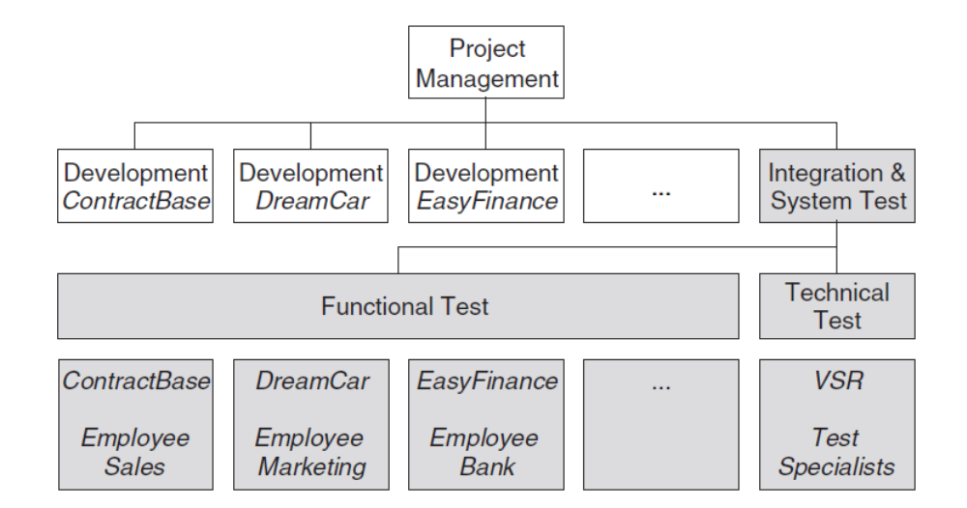

Chapter 6 Test Management
The final product shall be considered from the point of view of the customer and the end user. Therefore, independence from the development team is crucial. This leaves only models 3, 4, and 5.

Slide 7
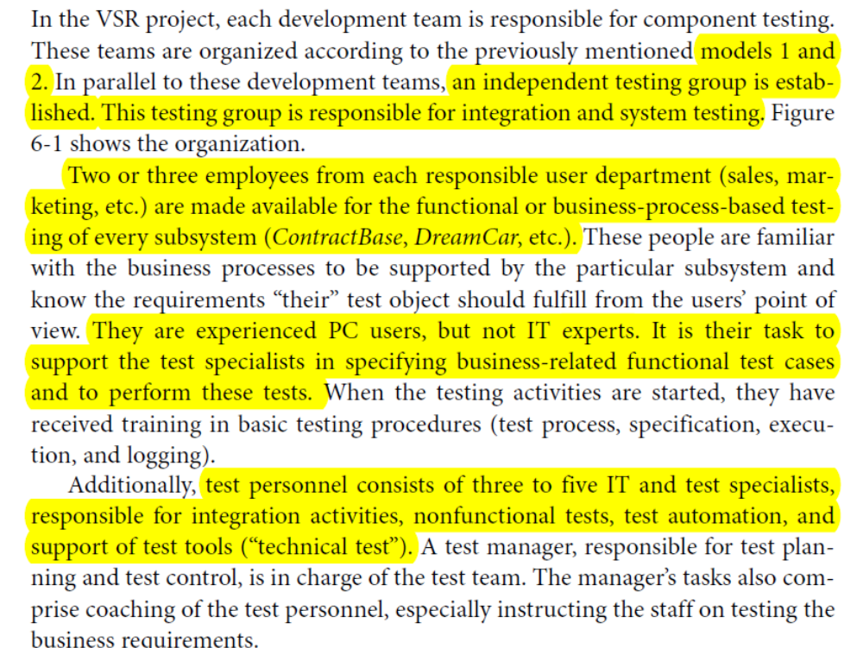
Chapter 6 Test Management

Slide 8
Chapter 6 Test Management
6.1.2 Tasks and Qualifications
Specialists with knowledge covering the full scope of activities in the test process should be available. The following roles should be assigned, ideally to specifically qualified employees:
■ Test manager (test leader): Test planning and test control expert(s),possessing knowledge and experience in the fields of software testing,quality management, project management, and personnel management.Typical tasks may include the following:
• Writing and coordinating the test policy for the organization
• Developing the test approach and test plan
• Representing the testing perspective in the project

Slide 9
Chapter 6 Test Management
• Procuring testing resources
• Selecting and introducing suitable test strategies and methods, introducing or improving testing tools, organizing tools training, deciding about test environment and test automation
• Introducing or optimizing supporting processes (e.g., problem management, configuration management) in order to be able to trace back changes and securing reproducibility of the tests
• Introducing, using, and evaluating metrics defined in the test plan
• Regularly adapting test plans based on test results and test progress
• Identifying suitable metrics for measuring test progress,

Slide 10
Chapter 6 Test Management
and evaluating the quality of the testing and the product
• Writing and communicating test reports
■ Test designer (test analyst): Expert(s) in test methods and test specification,having knowledge and experience in the fields of software testing,software engineering, and (formal) specification methods. Typical tasks may include the following:
• Reviewing requirements, specifications, and models for testability and in order to design test cases
• Creating test specifications
• Preparing and acquiring test data
■ Test automator: Test automation expert(s) with knowledge of testing basics, programming experience, and deep knowledge of the testing tools and script

Slide 11
Chapter 6 Test Management
languages. Automates tests as required, making use of
the test tools available for the project.
■ Test administrator: Expert(s) for installing and operating the test environment (system administrator knowledge). Sets up and supports the test environment (often coordinating with general system administration and network management).
■ Tester: Expert(s) for executing tests and reporting failures (IT basics,basic knowledge of testing, using the test tools, understanding the test object). Typical tasks are as follows:
• Reviewing test plans and test cases
• Using test tools and test monitoring tools (for example, to measure performance)

Slide 12
Chapter 6 Test Management
• Executing and logging tests, including evaluating and documenting the results and detected deficiencies
If appropriate resources are not available within the company, test activities can be given to external software testing service providers. This is similar to letting an external software house develop software. Based on their experience and their use of predefined solutions and procedures,these test specialists are able to provide an optimal test for the project.They can also provide missing specialist skills from each of the previously mentioned qualification profiles for the project.
6.2 Planning
Testing should not be the only measure for quality assurance (QA). It should be used in combination with other quality assurance measures.Therefore, an overall

Slide 13
Chapter 6 Test Management
plan for quality assurance is needed that should be documented in the quality assurance plan.
6.2.1 Quality Assurance Plan
Guidelines for structuring the quality assurance plan can be found in IEEE standard 730-2002 [IEEE 730-2002].
During quality assurance planning, the role the tests play as special, analytical measures of quality control is roughly defined. The details are then determined during test planning and documented in the test plan.

Slide 14
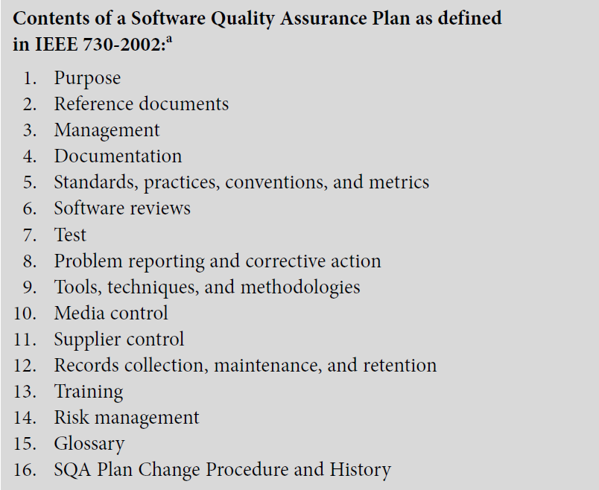
Chapter 6 Test Management

Slide 15
Chapter 6 Test Management
6.2.2 Test Plan
This planning and test preparation starts as early as possible in the software project. The test policy of the organization and the objectives, risks, and constraints of the project as well as the criticality of the product influence the test plan.
The test manager might participate in the following planning activities:
■ Defining the overall approach to and strategy for testing
■ Deciding about the test environment and test automation
■ Defining the test levels and their interaction, and integrating the testing activities with other project activities
■ Deciding how to evaluate the test results

Slide 16
Chapter 6 Test Management
■ Selecting metrics for monitoring and controlling test work, as well as defining test exit criteria
■ Determining how much test documentation shall be prepared and determining templates
■ Writing the test plan and deciding on what, who, when, and how much testing
■ Estimating test effort and test costs; (re)estimating and (re)planning the testing tasks during later testing work
The results are documented in the test plan. IEEE Standard 829-1998[IEEE 829] provides a template(there is new new standard [IEEE 829-2008]).
This structure works well in practice. The sections listed will be found in real test plans in many projects in the same, or slightly modified, form.

Slide 17
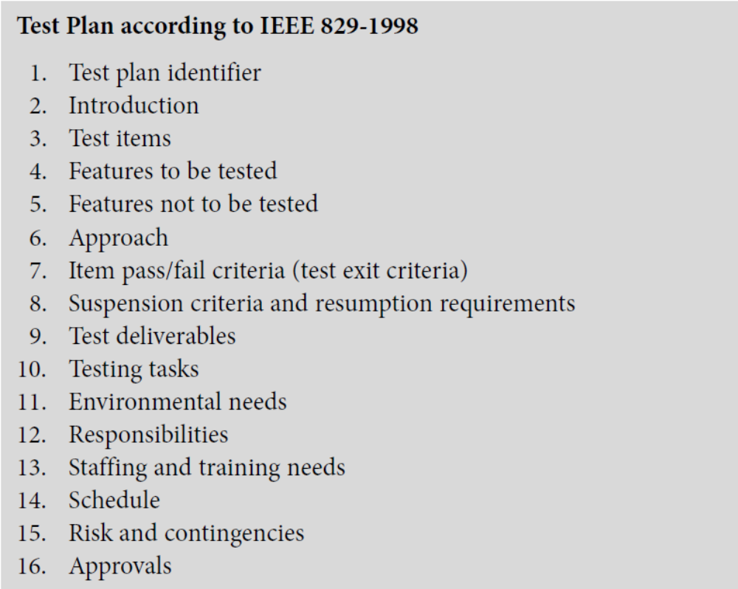
Chapter 6 Test Management

Slide 18
Chapter 6 Test Management
Test planning is a continuous activity for the test manager throughout all phases of the development project. The test plan and related plans must be updated regularly, based on feedback from test activities and reacting to changing project risks.
6.2.3 Prioritizing Tests
Even with good planning and control, it is possible that the time and budget for the total test, or for a certain test level, are not sufficient for executing all planned test cases.In this case, it is necessary to select test cases in a suitable way. Even with a reduced number of executable test cases, it must be assured that as many as possible critical faults are found. This means test cases must be prioritized.
Test cases should be prioritized so that if any test ends prematurely,the best possible test result at that point of

Slide 19
Chapter 6 Test Management
time is achieved.
Prioritization also ensures that the most important test cases are executed first. This important problems can be found early.
The criteria for prioritization, and thus for determining the order of execution of the test cases, are outlined next. Which criteria are used depends on the project, the application area, and the customer requirements.
The following criteria for prioritization of test cases may be used:
■ The usage frequency of a function or the probability of failure in software use.
■ Failure risk. Risk is the combination (mathematical product) of severity and failure probability.

Slide 20
Chapter 6 Test Management
■ The visibility of a failure for the end user is a further criterion for prioritization of test cases.
■ Test cases can be chosen depending on the priority of the requirements.
■ Besides the functional requirements, the quality characteristics may have differing importance for the customer.
■ Prioritization can also be done from the perspective of development or system architecture.
■ Complexity of the individual components and system parts can be used to prioritize test cases.
■ Failures having a high project risk should be found early
In the test plan, the test manager defines adequate priority

Slide 21
Chapter 6 Test Management
criteria and priority classes for the project. Every test case in the test plan should get a priority class using these criteria. This helps in deciding which test cases can be left out if resource problems occur.
Where many faults were found before.This phenomenon occurs often in projects.It must be possible to change test case priority.
Without prioritizing test cases, it is not possible to adequately allocate limited test resources. Concentration of resources on high-priority test cases is a MUST.
6.2.4 Test Entry and Exit Criteria
Defining clear test entry and exit criteria is an important part of test planning. Here are typical criteria,or checkpoints,that need to be fulfilled before executing the planned tests:

Slide 22
Chapter 6 Test Management
■ The test environment is ready.
■ The test tools are ready for use in the test environment.
■ Test objects are installed in the test environment.
■ The necessary test data is available.
These criteria are preconditions for starting test execution.
Exit criteria are used to make sure test work is not stopped by chance or prematurely. Here are some typical exit criteria and corresponding metrics or indicators:
■ Achieved test coverage: Tests run, covered requirements, code coverage,etc.
■ Product quality: Defect density, defect severity, failure rate, and reliability of the test object
■ Residual risk: Tests not executed, defects not repaired, incomplete coverage of requirements or code, etc.

Slide 23
Chapter 6 Test Management
■ Economic constraints: Allowed cost, project risks, release deadlines,and market chances
The test manager defines the project-specific test exit criteria in the test plan. During test execution, these criteria are then regularly measured and evaluated and serve as the basis for decisions by test and project management.
6.3 Cost and Economy Aspects
How much effort is adequate for testing a specific software product? When is the test cost higher than the possible benefit?To answer these questions, one must understand the potential defect costs due to lack of checking and testing. Then, one has to compare defect costs and testing costs.

Slide 24
Chapter 6 Test Management
6.3.1 Costs of Defects
If testing activities are reduced or cut out completely, there will be more undetected faults and deficiencies in the product. These remain in the product and may lead to the following costs:
■ Direct defect costs
■ Indirect defect costs
■ Costs for defect correction: Costs paid to vendors for fault correction.
It is hard to determine which types of costs will occur in reality, how likely it is, and how expensive it will be, that is, how high the failure cost risk is for a project.
It is crucial to find faults as early as possible after their creation. Defect costs grow rapidly the longer a fault

Slide 25
Chapter 6 Test Management
remains in the product.
6.3.2 Cost of Testing
The most important action to reduce or limit risk is to plan verification and test activities.But there are plenty of factors that influence the cost of such testing activities, and in practice they are difficult to quantify. The following list shows the most important factors that a test manager should take into account when estimating the cost of testing:
■ Maturity of the development process
• Stability of the organization
• Developer’s error rate
• Change rate for the software
• Time pressure because of unrealistic plans

Slide 26
Chapter 6 Test Management
• Validity, stability, and correctness of plans
• Maturity of the test process, and the discipline in configuration,change, and incident management
■ Quality and testability of the software
• Number, severity, and distribution of defects in the software
• Quality, expressiveness, and relevance of the documentation and other information used as test basis
• Size and type of the software and its system environment
• Complexity of the problem domain and the software (e.g., cyclomatic number)
■ Test infrastructure
• Availability of testing tools

Slide 27
Chapter 6 Test Management
• Availability of test environment and infrastructure
• Availability of experience with testing processes, standards, and procedures
■ Employee (project member) qualification
• Tester experience and know-how about the field of testing
• Tester experience and know-how about test tools and test environment
• Tester experience and know-how about the test object
• Collaboration between the tester, the developer, management, and customer
■ Quality requirements
• Intended test coverage

Slide 28
Chapter 6 Test Management
• Intended reliability or maximum number of remaining defects after testing
• Requirements for security and safety
• Requirements for test documentation
■ Test approach
• The testing objectives (themselves driven by quality requirements)and means to achieve them, such as number and comprehensiveness of test levels (component, integration, system test)
• The chosen test techniques (black box or white box)
• Test schedule (start and execution of the test work in the project or in the software life cycle)
6.3.3 Test Effort Estimation

Slide 29
Chapter 6 Test Management
Before defining a schedule and assigning resources, the test manager must estimate the testing effort to be expected.
For small projects, this estimation can be done in one step. For larger projects,separate estimations for each test level and test cycle may be necessary.
In general, two approaches for estimation of test effort are possible:
■ Listing all testing tasks; then letting either the task owner or experts who have estimation experience estimate each task
■ Estimating the testing effort based on effort data of former or similar projects, or based on typical values (e.g., average number of test cases run per hour)

Slide 30
Chapter 6 Test Management
6.4 Choosing the Test Strategy and Test Approach
A test strategy or approach defines the project’s testing objectives and the means to achieve them. It therefore determines testing effort and costs.Selecting an appropriate test strategy is one of the most important planning task decisions for a test manager.
6.4.1 Preventative vs. Reactive Approach
The point in time at which testers become involved highly influences the approach. We can distinguish two typical situations:
■ Preventive approaches are those in which testers are involved from the beginning: test planning and design start as early as possible. The test manager can really optimize testing, reduce testing costs and prevent defects.

Slide 31
Chapter 6 Test Management
Early test specification and preparation,as well as application of reviews and static analysis, contribute to finding defects early and thus lead to reduced defect density during test execution. When safety-critical software is developed, a preventive approach may be mandatory.
■ Reactive approaches are those in which testers are involved (too) late and a preventive approach cannot be chosen: test planning and design starts after the software or system has already been produced. Nevertheless, the test manager must find an appropriate solution even in this case. One very successful strategy in such a situation is called exploratory testing. This is a heuristic approach in which the tester “explores”the test object and test

Slide 32
Chapter 6 Test Management
design, test execution, and evaluation occur nearly concurrently.
Preventative approaches should be chosen whenever possible. Cost analysis clearly shows the following:
■ The testing process should start as early as possible in the project.
■ Testing should continuously accompany all phases of the project.
About VSR project ,pls see the next page.
6.4.2 Analytical vs. Heuristic Approach
During test planning and test design, the test manager may use different sources of information. Two extreme approaches are possible:

Slide 33
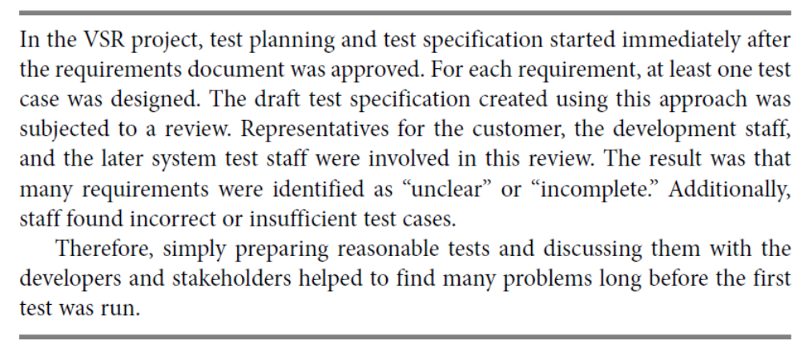
Chapter 6 Test Management
■ Analytical approach
Test planning is founded on data and (mathematical) analysis of it. The criteria discussed in section 6.3 will be quantified (at least partially) and their correlation will be modeled. The amount and intensity of testing are then chosen such that individual or multiple parameters (costs,

Slide 34
Chapter 6 Test Management
time, coverage, etc.) are optimized.
■ Heuristic approach
Test planning is founded on experience of experts (from inside or outside the project) and/or on rules of thumb. Reasons may be that no data is available, mathematical modeling is too complicated, or the necessary know-how is missing.
The approaches used in practice are between these extremes and use (to different degrees) both analytical and heuristic elements:
■ Model-based testing uses abstract functional models of the software under test for test case design, to find test exit criteria, and to measure test coverage. An example is state-based testing (see section 5.1.3),where state

Slide 35
Chapter 6 Test Management
transition machines are used as models.
■ Statistical or stochastic (model-based) testing uses statistical models about fault distribution in the test object, failure rates during use of the software (such as reliability growth models), or the statistical distribution of use cases (such as operational profiles) to develop a test approach. Based on this data, the test effort is allocated and test techniques are chosen.
■ Risk-based testing uses information on project and product risks and directs testing to areas with high risk. This is described in more detail in the next section.
■ Process- or standard-compliant approaches use rules, recommendations(Such recommendations contain a lot of heuristics and experience-based knowledge), and standards (e.g., the V-model or IEEE 829) as a “cookbook.”

Slide 36
Chapter 6 Test Management
■ Reuse-oriented approaches reuse existing test environments and test material. The goal is to set up testing quickly by maximal reuse.
■ Checklist-based (methodical) approaches use failure and defect lists from earlier test cycles,lists of potential defects or risks,or prioritized quality criteria and other less formal methods.
■ Expert-oriented approaches use the expertise and “gut feeling” of involved experts (for the technology used or the application domain).Their personal feeling about the technologies used and/or usage domain influences and controls their choice of test approach.
These approaches are seldom used as they are described. Generally, a combination of several approaches is used to develop the testing strategy.

Slide 37
Chapter 6 Test Management
6.4.3 Testing and Risk
When looking for criteria to select and prioritize testing goals, test methods, and test cases, one of the best criteria is risk. Risk is defined as the mathematical product of the loss or damage due to failure and the probability (or frequency) of failure resulting in such damage.The probability of occurrence of a product failure depends on the way the software product is used. The software’s operational profile must be considered here.
Risk factors to be considered may arise from the project (project risks) as well as from the product to be delivered (product risks).
Project risks are risks that threaten the project’s capability to deliver the product:

Slide 38
Chapter 6 Test Management
■ Supplier-side risks such as, for example, the risk that a subcontractor fails to deliver or fighting about the contract. Project delays or even legal action may result from these risks.
■ An often-underestimated organizational risk is lack of necessary resources (total or partial lack of personnel with the necessary skills;recognizing necessary training but not implementing it), problems of human interaction (e.g., if testers or test results do not get adequate attention), or internal power struggles such as no or insufficient cooperation between different departments.
■ Technical problems are another project risk. Wrong, incomplete, fuzzy,or infeasible requirements may lead to project failure. If new technologies,tools, programming languages, or methods are applied without sufficient

Slide 39
Chapter 6 Test Management
experience, the expected result—to get better results faster—may easily turn into the opposite. Another technical project risk is that the quality of intermediate results is too low (design documents, program code, or test cases) or that defects have not been detected and corrected. There are even risks for the test itself—for example, if the test environment is not ready or the test data is incomplete.
Product risks are risks resulting from problems with the delivered product:
■ The delivered product has inadequate functional or nonfunctional quality. Or the quality of the data to be processed is poor (for example,because of faults in previous data migration or conversion).

Slide 40
Chapter 6 Test Management
■ The product is not fit for its intended use and is thus unusable.
■ The use of the product causes harm to equipment or even endangers human life.
The [IEEE 730] and [IEEE 829] standards for quality assurance and test plans demand systematic risk management. This comprises the following actions:
■ Regularly identifying what can go wrong (risks)
■ Prioritizing identified risks
■ Implementing actions to mitigate or fight those risks
An important risk mitigation activity is testing; testing provides information about existing problems and the success or failure of correction. Testing decreases uncertainty about risks, helps to estimate risks, and

Slide 41
Chapter 6 Test Management
identifies new risks.
Risk-based testing helps to minimize and fight product risks from the start of the project. Risk-based testing uses information about identified risks for planning, specification, preparation, and execution of the tests.
All major elements of the test approach are determined based on risk:
■ The test techniques to be used
■ The extent of testing
■ The priority of test cases
Even other risk-minimizing measures, such as training for inexperienced software developers, are considered as supplements to measures for testing.

Slide 42
Chapter 6 Test Management
6.5 Managing The Test Work
Every cycle through the testing process usually results in tasks for correction or changes for the developers. When bugs are corrected or changes are implemented, a new version of the software comes into life, and it must be tested. In every test level, the test process is repeatedly executed.
The test manager has to initiate these test cycles, monitor their progress, and control the test work. Depending on the size of the project, a test level may be managed by its own test manager.
6.5.1 Test Cycle Planning

Slide 43
Chapter 6 Test Management
Section 6.2 described the initial test planning (test approach and general work flow). This should be developed early in a project and described in the test plan.
This general plan must be detailed in a detailed plan for the concrete test cycle to be run next, and it must be adapted to the current project situation.The following points should be addressed:
■ State of development: The software available at the start of the test cycle may have less or different functionality than originally planned for. The test specification and test cases may need to be adapted.
■ Test results: Problems discovered in earlier test cycles might require changed test priorities. Fixed defects require additional confirmation tests (retests), and these must be planned. Additional tests may be necessary because some

Slide 44
Chapter 6 Test Management
problems may be difficult or impossible to reproduce or analyze.
■ Resources: The plan for the current test cycle must be consistent with the project plan. Attention must be given to personal disposition planning,holiday planning, availability of test environment, and special tools.
Using these preconditions, the test manager estimates effort and duration of the test work and plans in detail which test cases shall be executed by which tester, in which order, and at which points of time. The result of this detailed planning is the plan for the next test cycle or regression test cycle.
6.5.2 Test Cycle Monitoring
To measure and monitor the results of the ongoing tests,

Slide 45
Chapter 6 Test Management
objective test metrics should be used. They are defined in the test plan. Only metrics that are reliably, regularly, and simply measurable should be used. These approaches are possible:
■ Fault- and failure-based metrics
Number of encountered faults and number of generated incident reports (per test object) in the particular release. This should also include the problem class and status, and, if possible, a relation to the size of the test object (lines of code), test duration, or other measures (see section 6.6).
■ Test-case-based metrics
Number of test cases in a certain state, like specified or planned,blocked (e.g., because of a fault not being eliminated), number of test cases run (passed or failed).

Slide 46
Chapter 6 Test Management
■ Test-object-based metrics
Coverage of code, dialogs, possible installation variants, platforms, etc.
■ Cost-based metrics
Test cost until now, cost of the next test cycle in relation to expected benefit (prevented failure cost or reduced project or product risk).
The test manager lists the current measurement results in the test reports.After each test cycle, a test status report should show the following information about the status of the test activities:
■ Test object(s), test level, test cycle date from … to …
■ Test progress: tests planned/run/blocked
■ Incident status: new/open/corrected

Slide 47
Chapter 6 Test Management
■ Risks: new/changed/known
■ Outlook: planning of the next test cycle
■ Assessment: (subjective) assessment of the maturity of the test object,the possibility for release, or the current confidence
A template for such a report can be found in [IEEE 829].
On the one hand, the measured data serves as a means to determine Test exit criteria the current situation and to answer the question, How far has the test progressed? On the other hand, the data serves as exit criterion and to answer the question, Can the test be finished and the product be released? The quality requirements to be met (the product’s criticality) and the available test resources (time, personnel, test tools) determine which criteria are

Slide 48
Chapter 6 Test Management
appropriate for determining the end of the test. The test exit criteria for the current project are also documented in the test plan. It should be possible to decide about each test exit criterion based on the collected test metrics.
6.5.3 Test Cycle Control
If testing is delayed with respect to the project and test planning, the test manager must take suitable countermeasures. This is called test (cycle) control. These actions may relate to the test or any other development activity.
It may be necessary to request and deploy additional test resources (personnel, workstations, and tools) in order to compensate for the delay and catch up on the schedule in the remaining cycles.

Slide 49
Chapter 6 Test Management
If additional resources are not available, the test plan must be adapted.Test cases with low priority will be omitted. If test cases are planned in several variants, a further option is to only run them in a single variant (for example, tests are performed on one operating system instead of several). Although these adjustments lead to omission of some interesting tests, the available resources can at least make it possible to execute the high-priority test cases.
Depending on the severity of the faults and problems found, test duration may be extended. This happens because additional test cycles become necessary, because the corrected software must be retested after each correction cycle (see section 3.7.4). This could mean that the product release must be postponed.

Slide 50
Chapter 6 Test Management
It is important that the test manager documents and communicates every change in the plan because the change in the test plan may increase the release risk (product risk). The test manager is responsible for communicating this risk openly and clearly to the people responsible for the project.
6.6 Incident Management(defect management)
To ensure reliable and fast elimination of failures detected by the various test levels, a well-functioning procedure for communicating and managing those incident reports is needed.Incident management starts during test execution or upon test cycle completion by evaluating the test log.
6.6.1 Test Log
After each test run, or at the latest upon completion of a

Slide 51
Chapter 6 Test Management
test cycle, the test logs are evaluated. Real results are compared to the expected results. If the test was automated, the tool will normally do this comparison immediately. The testers ascertain whether a deviation from the predicted outcome really has occurred or whether an incorrectly designed test case, incorrect test automation, or incorrect test execution caused the deviation (testers, too, can make mistakes).
If the test object caused the problem,12 a defect or incident report is created. This is done for every unexpected behavior or observed deviation from the expected results found in the test log
6.6.2 Incident Reporting
In general, a central database is established for each project, in which all incidents and failures discovered

Slide 52
Chapter 6 Test Management
during testing (and possibly during operation) are registered and managed. All personnel involved in development as well as customers and users can report incidents. These reports can refer to problems in the tested (parts of) programs as well as to faults in specifications, user manuals, or other documents.
Incident reporting is also referred to as problem, anomaly, defect, or failure reporting.Incident reporting is not a one-way street because every developer can comment on reports—for example, by requesting comments or clarification from a tester or by rejecting an unjustified report.
At any point in time, the incident database enables the test manager and the project manager to get an up-to-date and complete picture of the number and state of problems and

Slide 53
Chapter 6 Test Management
about the progress of corrections. For this purpose, the database should offer appropriate possibilities for reporting and analysis.
The test manager should define the incident report template.In addition to the description of the problem, the incident report typically contains information identifying the tested software, test environment,name of the tester, and defect class and prioritization as well as other information that’s important for reproducing and localizing the fault.
the following figure shows an example of an incident report template:

Slide 54
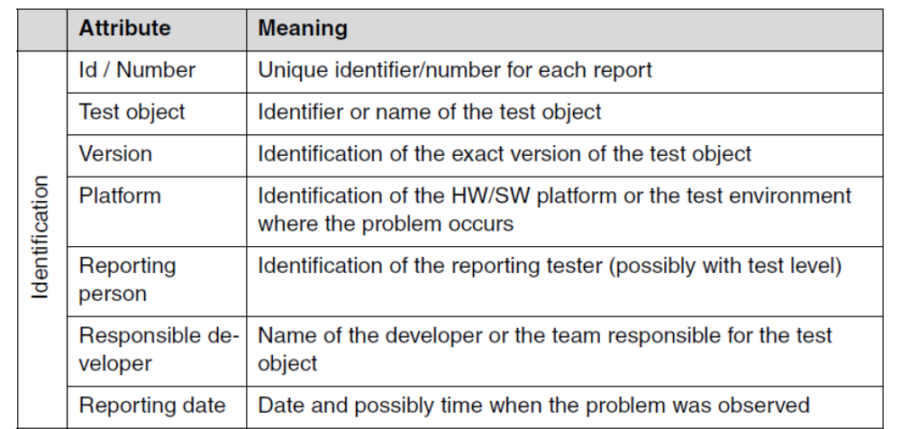
Chapter 6 Test Management

Slide 55
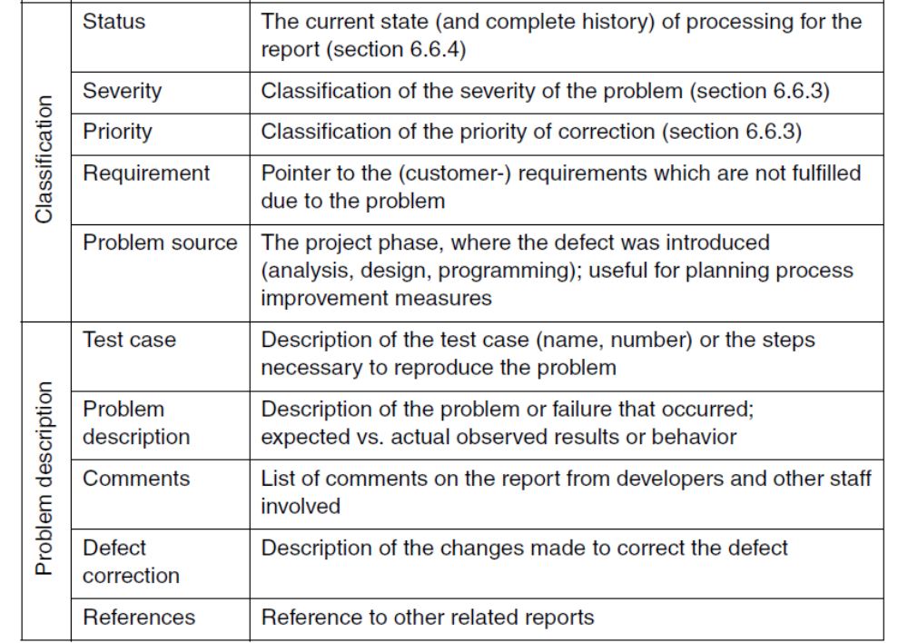
Chapter 6 Test Management

Slide 56
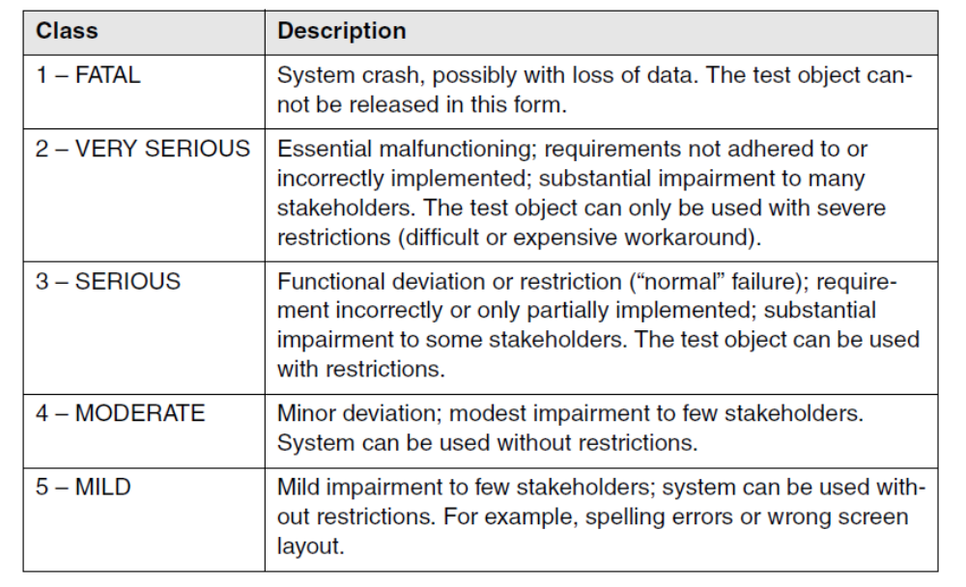
Chapter 6 Test Management
6.6.3 Defect Classification
Defect severity can be classified using the classes given in following figure.

Slide 57
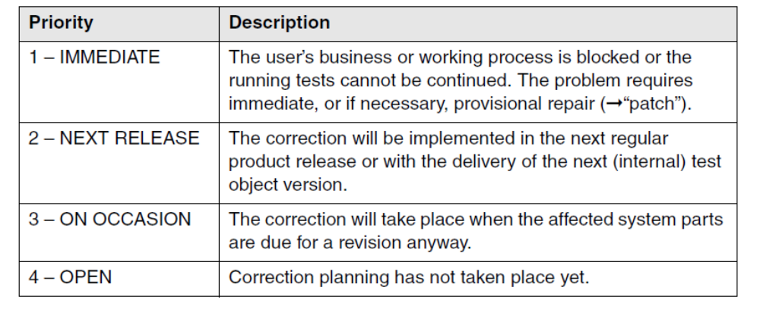
Chapter 6 Test Management
The defect severity classifications do not indicate how quickly a particular problem should be corrected.Priority associated with handling the problem (fault priority or defect priority or correction priority,for example correction complexity will be considered) is a different matter and should not be confused with severity.
The following figure is the classification of fault priority:

Slide 58
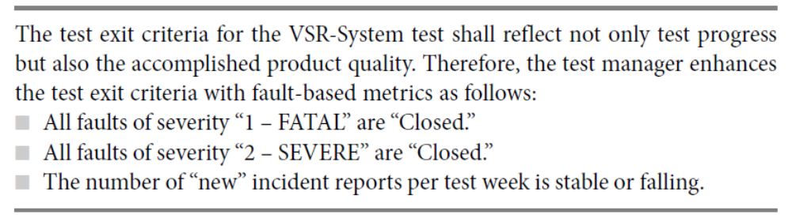
Chapter 6 Test Management
6.6.4 Incident Status
The following table(page 59-60) shows an example for an incident status scheme and figure(page 61) demonstrates this procedure.
the following hint is the test exit criteria for the VSR-System:

Slide 59
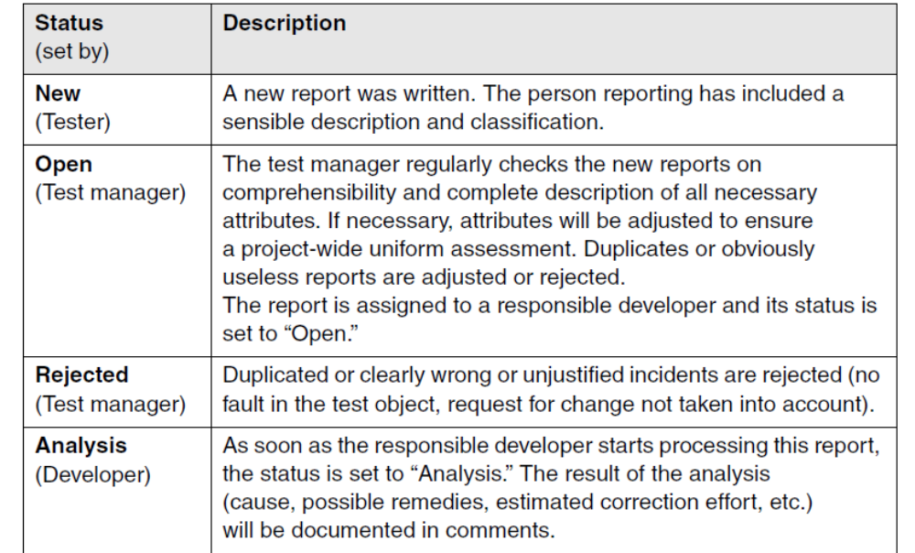
Chapter 6 Test Management

Slide 60
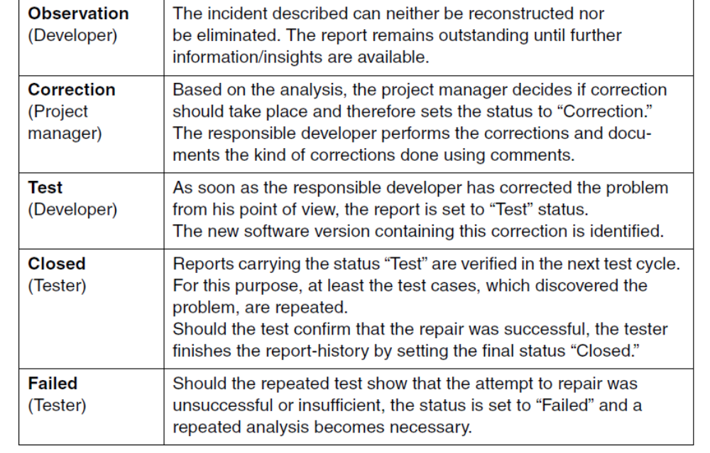
Chapter 6 Test Management

Slide 61
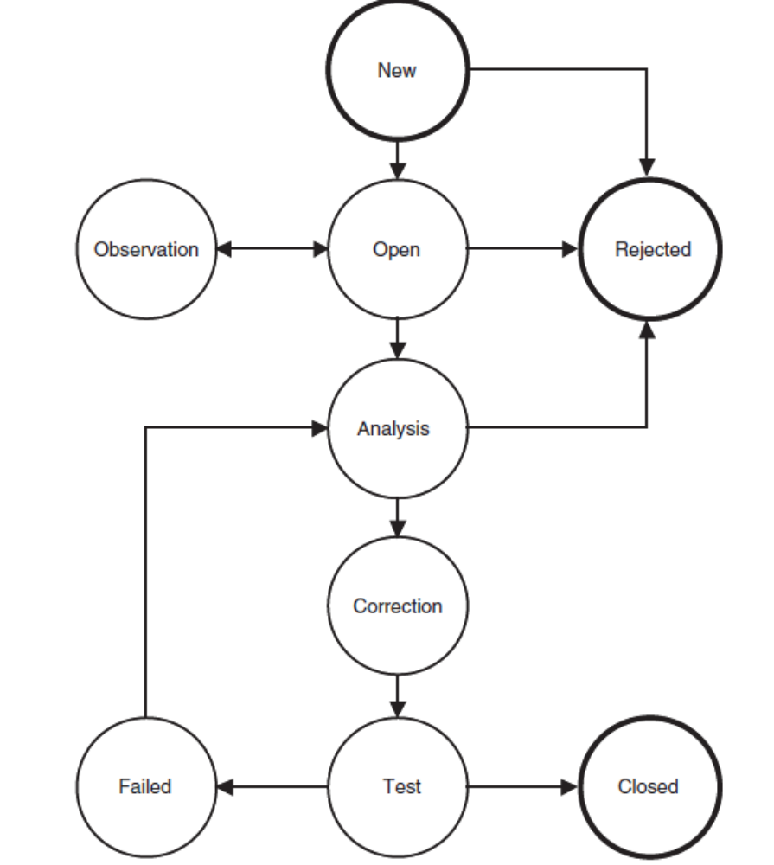
Chapter 6 Test Management

Slide 62
Chapter 6 Test Management
6.7 Requirements to Configuration Management
If configuration management is not done properly in a project, the following typical symptoms may be observed:
■ Developers mutually overwrite each other’s modifications in the source code or other documents because simultaneous access to shared files is not avoided.
■ Integration activities are impeded(it is unclear which code versions of a specific component exist in the development team and which ones are the current versions....)
■ Problem analysis, fault correction, and regression tests are complicated
■ Tests and test evaluation are impeded(it is unclear which test cases belong to which version of a test object....)

Slide 63
Chapter 6 Test Management
Insufficient configuration management thus leads to a number of possible problems disturbing the development and test process. If, for example, it is unclear during a test level whether the examined test objects are the latest version, the tests rapidly lose any significance. A test process cannot be properly executed without reliable configuration management.
From the perspective of the test, the following requirements should be met:
■ Version management
This is the cataloguing, filing, and retrieval of different versions of a configuration item (for example, version 1.0 and 1.1 of a component consisting of several files). This also includes securing comments onthe reason for the particular change.

Slide 64
Chapter 6 Test Management
■ Configuration identification
This is the identification and management of all files (configuration objects) in the particular version, which together comprise a subsystem (configuration). The prerequisite for this is version management.
■ Incident and change status control
■ Configuration audits
To check the effectiveness of configuration management, it is useful to organize configuration audits. Such an audit offers the possibility to check whether the configuration management documented all software components, whether configurations can be correctly identified,etc.
A configuration management plan must therefore determine a process tailored to the project situation. A

Slide 65
Chapter 6 Test Management
standard for configuration management and respective plans can be found in [IEEE 828].

